Slide 1
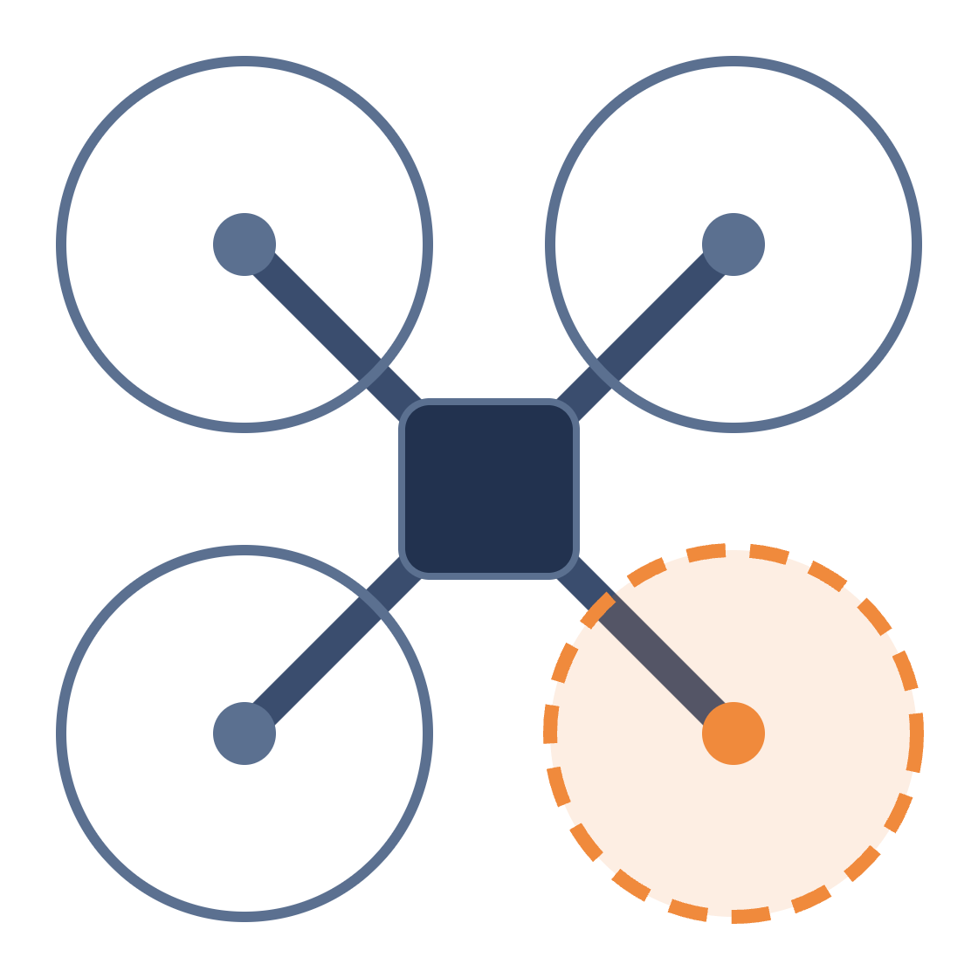
Fault-Tolerant Quadrotor Control
INTRODUCTION TO UAV DESIGN · PROJECT 6
Objectives, solution framework, deliverables and components
50% RPM
[Team name] · [Member names]
Project presentation · 27 October 2026
Notes:
Hi, we’re [team name]. Our project is number 6: a quadrotor that keeps flying its waypoint mission when one motor is cut to half speed. The orange rotor in the picture is that motor. We’ll go through four things: our objectives, our solution framework, the deliverables we’re committing to, and the components we’ll use.

Slide 2
What we will build and demonstrate
1 · OBJECTIVES
01
Build a quadrotor with enough spare thrust to fly with one motor at 50% RPM
02
Fly an autonomous waypoint mission with all four motors healthy (our baseline)
03
When told “motor k is at 50%”, adapt the controller and stay stable
04
After the fault, finish the mission or return and land safely
05
Back every result with flight logs and measured data
Out of scope, as the brief says: detecting the fault. We’re told which motor is weak and when.
Project 6 · Fault-Tolerant Quadrotor Control
2
Notes:
Our objectives come straight from the project brief. First, the drone itself: it needs enough spare thrust that one motor at half speed doesn’t bring it down. Second, a normal autonomous waypoint mission with all motors healthy. That’s our baseline, and everything after the fault gets compared against it. Third, when we’re told a motor is at 50%, the controller adapts and keeps the drone level. Fourth, after the fault the drone either finishes the mission or flies back and lands. Fifth, every result we report comes from flight logs. One thing we don’t do is detect the fault. The brief says we’re told which motor and when.

Slide 3
Half the speed leaves a quarter of the thrust
1 · OBJECTIVES · WHY IT’S HARD
25%
No spare motor
Four motors handle lift, roll, pitch and yaw. Weaken one and all four jobs are affected.
It tips toward the weak corner
That corner loses lift, so the drone rolls and pitches toward it.
of its normal maximum thrust is all the weak motor has left
It starts to turn
thrust ∝ RPM² → 0.5² = 0.25
The clockwise and anticlockwise torques stop cancelling out, so the heading drifts.
Project 6 · Fault-Tolerant Quadrotor Control
3
Notes:
Here’s why the problem is hard. Propeller thrust goes with the square of its speed, so half the RPM gives about a quarter of the thrust, not half. A quadrotor has no spare motor; the four motors share lift, roll, pitch and yaw between them. Weaken one corner and the drone tips toward it. And since two motors spin clockwise and two anticlockwise, their twisting forces stop cancelling, so the drone also starts to turn. The controller has to deal with all three at once.

Slide 4

Start with enough thrust margin
2 · SOLUTION FRAMEWORK · KEY IDEA
≈650 g
≈163 g
≈300 g
Estimated total weight of the drone
Thrust each motor needs to hover
What the weak motor still gives (25% of ≈1.2 kg)
Thrust-to-weight ≈ 7:1. The break-even point is 4:1, and we’re aiming for at least 5:1.
So the weak motor can still hold up its corner, and our job is to re-plan the motor commands around it.
Estimates · we’ll measure the real numbers once parts arrive
4
Notes:
This is our main design decision. Our drone should weigh about 650 grams, so each motor needs about 163 grams of thrust to hover. The motors we picked give about 1.2 kilograms each at full speed. A quarter of that is about 300 grams, which is still more than the weak motor needs to hold up its corner. The break-even point is a thrust-to-weight ratio of 4:1, because a quarter of 4 is 1. We’re aiming for 5:1 or more, and our estimate is around 7:1. These are estimates; we’ll measure the real numbers once the parts arrive. If asked why not a bigger 450 mm frame: to reach 5:1 on a frame that size you need much bigger motors and batteries, which costs a lot more. A 5-inch frame gets there cheaply and is easy to fix after a crash.

Slide 5
Where our code fits in the flight stack
2 · SOLUTION FRAMEWORK · ARCHITECTURE
Waypoint mission
Position controller
Attitude & rate controller
WE CHANGE
ESCs and 4 motors
Control allocation
WE ADD 01
WE ADD 02
WE ADD 03
Fault interface
Fault-aware allocation
Mission logic
Receives “motor k is now at 50%”
Knows motor k’s new limit and moves work to the other three
Decides whether to carry on or return and land
We build on PX4, an open-source autopilot, and only change the parts the fault affects.
Project 6 · Fault-Tolerant Quadrotor Control
5
Notes:
This is the flight stack, left to right. The mission says where to go next. The position controller decides which way to tilt. The attitude and rate controllers work out how much roll, pitch and yaw is needed. Control allocation, the mixer, turns that into a speed for each motor. We’re using PX4, an open-source autopilot, so we don’t have to build stable flight from scratch. We add three pieces: the fault interface, a fault-aware allocator, and the mission logic that decides what to do after the fault. If asked why PX4: it’s open source, it already does waypoint missions and detailed logging, and its control allocation is a separate module we can modify. That module is exactly what our project is about.

Slide 6
Tell the mixer motor k is weaker
2 · SOLUTION FRAMEWORK · CONTROL REALLOCATION
[T, τx, τy, τz] = B · [f1, f2, f3, f4]
1 · Update the limit
normal: 0 ≤ fi ≤ fmax
The allocator learns motor k’s new maximum and plans around it.
fault: 0 ≤ fk ≤ 0.25 · fmax
2 · Set priorities
B maps the four motor thrusts (f1–f4) to total lift T and the roll, pitch and yaw moments.
Lift, roll and pitch come first. If something has to give, it’s yaw; a slow heading drift is acceptable.
PX4’s default mixer doesn’t know about the limit. It keeps asking motor k for thrust it can’t give, the motor saturates, and the drone tilts.
3 · Reconfigure the limits
After the fault we lower speed, climb rate and tilt, so commands stay within reach.
Project 6 · Fault-Tolerant Quadrotor Control
6
Notes:
This is the core of our software. The mixer solves one equation: the controller asks for total lift plus roll, pitch and yaw, and the mixer finds four motor thrusts that produce it. Normally each motor can go anywhere between zero and full. After the fault, motor k tops out at about a quarter of its normal thrust. We handle that in three steps. We give the allocator the new limit, so it plans around it instead of asking for something impossible. We set priorities: staying level and holding height come first, and if something has to give, it’s yaw, so the heading may drift a little. And after the fault we lower the speed, climb-rate and tilt limits, so the controller rarely needs more than the weak motor can give. If asked whether hover is fine anyway at 7:1: yes, in calm hover the weak motor has enough. The trouble comes in climbs, turns, braking and gusts, when the controller suddenly wants more from one motor. The default mixer doesn’t know the limit, so it saturates and the drone tilts. Ours plans around it, and we’ll show the difference in simulation logs.

Slide 7
How the fault reaches our controller
2 · SOLUTION FRAMEWORK · FAULT INTERFACE
On demo day
While testing, we inject it ourselves
The evaluator caps motor k at 50% RPM
The notification arrives as a MAVLink command or an RC switch
PX4 turns it into an internal motor_fault message: {k, 50%}
The allocator and mission logic switch to fault mode
One RC switch caps motor k and sends the notification together
We calibrate the cap on the bench from the ESCs’ RPM readings
Everything runs in the PX4 simulator before it touches the drone
We’d like to confirm how the fault will be applied and signalled on demo day, so our interface matches it.
Project 6 · Fault-Tolerant Quadrotor Control
7
Notes:
The brief says the fault is injected from outside and the controller is told about it. So we need a clear way for the message “motor k is at 50%” to reach our code. We plan to accept it either as a MAVLink command from the ground station or as an RC switch. Inside PX4 it becomes an internal message that both the allocator and the mission logic listen for. While testing, we have to create the fault ourselves. One switch on our remote will cap motor k and send the notification at the same time. Throttle and RPM aren’t the same thing, so we’ll measure the real motor speed from the ESCs’ RPM readings and calibrate the cap on the bench. If asked how we know it’s really 50% RPM: we measure it directly from ESC telemetry and log it in every test.

Slide 8
Carry on, or come home and land
2 · SOLUTION FRAMEWORK · AFTER THE FAULT
ALL YES
Continue the mission
STEP 1
STEP 2
STEP 3
Fly the remaining waypoints, more slowly
Fault received
Settle
Health check
Motor k is capped at 50% RPM
Hold position for a few seconds
Tilt error small? Holding position? Enough battery?
ANY NO
Return and land
Fly back slowly and land
Both endings meet the brief. Finishing the mission is what we’re aiming for.
Project 6 · Fault-Tolerant Quadrotor Control
8
Notes:
The brief allows two endings after the fault: continue the mission, or stop and land safely. Our drone decides on its own. As soon as the fault arrives, it holds position for a few seconds to settle. Then it checks three things: is the tilt error small, is it holding position, and is there enough battery left. If all three pass, it flies the remaining waypoints more slowly. If any one fails, it flies back and lands. Either ending meets the brief; finishing the mission is what we’re aiming for. If asked for exact thresholds: we’ll set them from simulation and tethered tests, roughly a few degrees of tilt error and under half a metre of position error, and report the values we pick.

Slide 9
What we commit to deliver
3 · DELIVERABLES
# | Deliverable | How we’ll show it
D1 | Quadrotor sized for the fault (T/W ≥ 5:1) | Parts list, thrust test, flying prototype
D2 | Stable baseline autonomous flight controller | Tuned PX4; attitude and position logs
D3 | Autonomous waypoint navigation | Planned vs flown path plots
D4 | Interface for receiving the fault notification | Logs show the switch to fault mode
D5 | Fault-tolerant strategy: fault-aware allocation | Code, analysis, sim vs default mixer
D6 | Controller reconfiguration after the fault | Motor outputs and limits, before vs after
D7 | Baseline and post-fault flight demonstrations | Side-by-side logs from both flights
D8 | Continue the mission or end it safely | A post-fault flight that finishes or lands
D9 | Flight logs, data and technical report | Raw logs, analysis scripts, report
D1–D8 follow the project brief; D9 covers the common deliverables
9
Notes:
These are the deliverables we’re committing to. They follow the brief’s list one to one, and the right column says how we’ll prove each. D1 is the drone itself, sized for the fault. D2 and D3 are normal flight: a stable, tuned controller and an autonomous waypoint mission. D4 to D6 are the fault handling: the notification interface, the fault-aware allocation, and the tighter limits after the fault. D7 is the pair of demo flights, one healthy and one with the fault. D8 is the decision after the fault: finish or land. D9 is the logs, data and report that every team submits. Since deliverables can’t change after today, we’ve kept this list to what the brief asks for. The extras are on the next slide as stretch goals.

Slide 10
Stretch goals, and what’s out of scope
3 · DELIVERABLES · SCOPE
IF TIME ALLOWS · NOT COMMITTED
NOT PART OF THIS PROJECT
Stretch goals
Out of scope
Finish the full mission after the fault in every trial
A closed-loop RPM cap that holds 50% as the battery drains
Compare the default mixer with ours in real flight (we commit to this in simulation only)
Detecting or identifying the fault (the brief excludes it)
Other faults, such as a fully stopped motor or a sensor failure
After the fault, our commitment is to finish the mission or land safely, as the brief allows.
Project 6 · Fault-Tolerant Quadrotor Control
10
Notes:
To be clear about scope: these stretch goals are things we’ll try if time allows, but we’re not committing to them. Finishing the full mission in every single trial is hard, so our commitment is “finish or land safely”. A closed-loop RPM cap would hold exactly 50% as the battery drains. And comparing the default mixer against ours in real flight is risky, because the default may crash, so we commit to that comparison in simulation only. Out of scope: detecting the fault, which the brief excludes, and other kinds of fault, like a fully stopped motor.

Slide 11
Picked for thrust margin
4 · COMPONENTS · AIRFRAME AND PROPULSION
Component | Our choice | Why we need it
Frame | 5″ carbon X, ~250 mm | Light, survives crashes, and spare arms are cheap
Motors ×4 | 2306, ~2450 KV, 4S | Enough thrust for T/W ≈ 7:1, so the weak motor still holds its corner
ESC (4-in-1) | 45–55 A, RPM telemetry | Lets us measure and log the real motor RPM
Propellers | 5″ tri-blade, 10 sets | Matched to the motors; props break, so we need spares
Batteries ×3 | 4S LiPo, 1300–1500 mAh | Several test flights per session, since a charge takes an hour
Project 6 · Fault-Tolerant Quadrotor Control
11
Notes:
Every propulsion part follows one rule: thrust-to-weight of at least 5:1, so the weak motor can still carry its share. Frame: a 5-inch carbon frame is light, survives crashes, and a broken arm is cheap to replace. We expect a few crashes while testing the fault. Motors: 2306 motors at around 2450 KV on a 4-cell battery give roughly 1.2 to 1.5 kg of thrust each. That puts us near 7:1. ESC: these report the actual motor RPM, which is how we prove the weak motor really is at 50% and log it for the report. One 4-in-1 board keeps the wiring simple. Props and batteries: props break easily, so we’re buying plenty. Three batteries mean several flights per session, since a charge takes about an hour. If asked why 4S and not 6S: 4S parts and chargers are cheaper and easier to find, and 4S already gives us enough thrust.

Slide 12
Picked for coding and safe testing
4 · COMPONENTS · CONTROL, SENSING AND SAFETY
Component | Our choice | Why we need it
Flight controller | H7 board running PX4 | We can change its allocation code, and it logs every flight
Position sensor | GPS + compass (outdoor) or optical flow (indoor) | The drone has to know where it is to fly waypoints
Telemetry link | WiFi module or SiK radio | Carries the fault notification; we watch the flight live
RC transmitter + receiver | With two spare switches | Kill switch (a safety rule) and a fault on/off switch for tests
Test gear | Tether rig, spare motor and arm | Safe first fault tests; quick repairs after a crash
Estimated total ≈ ₹45,000–55,000, less with items borrowed from the lab
12
Notes:
Flight controller: an H7 board that runs PX4. We need to change its control allocation, and we need its flight logs for the report. Position sensor: waypoints need the drone to know where it is. Outdoors that’s GPS with a compass. GPS doesn’t work indoors, so there we’d use an optical-flow sensor. It depends on where the demo happens. Telemetry: the link between the drone and the laptop. It carries the fault notification and lets us watch the flight live. RC transmitter: the safety rules require a manual override and kill switch. We use a second switch to turn the test fault on and off. Test gear: the tether lets us try the fault without the drone flying off, and spare parts mean a crash costs us hours, not a week. Budget is roughly 45 to 55 thousand rupees, less if the lab can lend the transmitter, charger or tools. If asked why not a cheaper Betaflight board: Betaflight can’t fly autonomous waypoint missions and isn’t built to be modified this way.

Slide 13
A few points we’d like to confirm
BEFORE WE FINALIZE
How will the fault be applied and signalled on demo day?
Will the demo be indoors or outdoors?
Can we build on PX4, with our own allocation and mission code?
Does the lab provide a base drone, parts or a budget?
Thank you. Questions welcome.
13
Notes:
We’d like to settle these four points, since the deliverables are fixed after today. The answers decide how we build the fault interface, which position sensor we buy, what software we start from, and our budget. Answers to other questions we might get: Why not a hexacopter? The brief asks for a quadrotor. A hexacopter has spare motors, which would make the fault much easier and miss the point. Will you detect the fault? No. The brief says we’re told which motor is weak. What happens to yaw? We lose some yaw authority. We keep the drone level and on position first, and accept a slow heading drift. How is this different from what PX4 already does? Stock PX4 doesn’t know a motor is weaker; it only reacts once that motor saturates. Ours knows the limit in advance and plans around it, and our mission logic decides whether to carry on or land. What if it can’t hold position after the fault? The health check fails and the drone returns and lands, which still meets the brief.

